Slide 1

Trends and Lessons in
Working From Home
Nick Bloom (Stanford)
OECD, June 2020

Slide 2



WFH coverage in US newspapers doubled from 2000 to January 2020
Source: Newsbank Access World News collection of approximately 2000 national and local daily US newspapers. Shows the % of articles mentioning “working from home” or “WFH”. Daily data plotted as a weekly average. Data until January 2020
Mitch McConnell and Rand Paul working from home due to injuries
Marissa Mayer at Yahoo recalls a working-from-home team to the office, Feb 22nd 2013
Notes:
Mitch McConnell broke his shoulder falling in his garden and Rand Paul had an operation on his lung following an incident when a neighbor “tackled him”. Typical newspaper about 200 articles a day, so 0.5% is about 1 per day

Slide 3
But increased another 120 times (12,000%) by March 2020!
March 10th ≈ start of COVID lockdown
Source: Newsbank Access World News collection of approximately 2000 national and local daily US newspapers. Shows the % of articles mentioning “working from home” or “WFH”. Daily data plotted as a weekly average. Data until January 2020

Slide 4

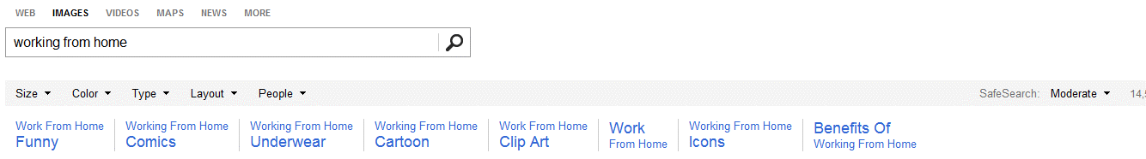
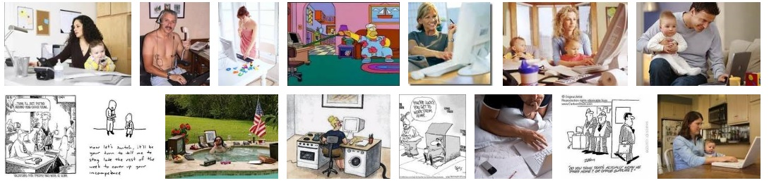
Working from home traditionally had a bad image (a 2017 search)

Slide 5


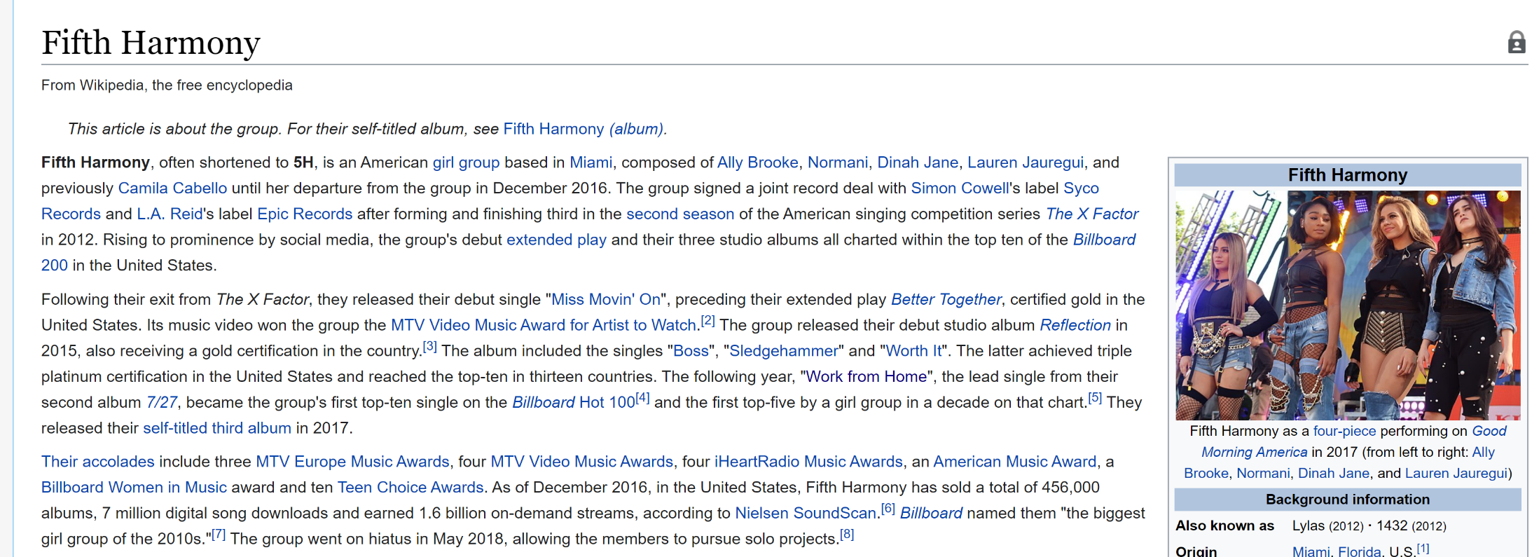
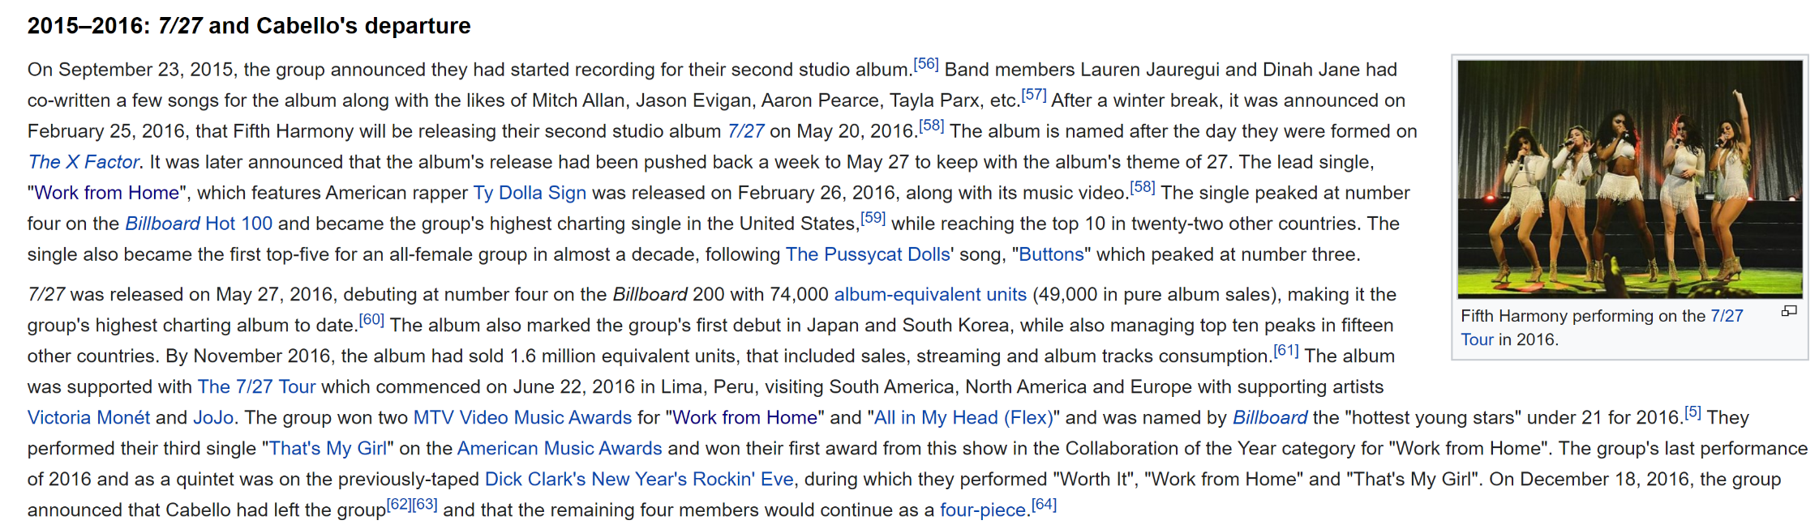
'WORK FROM HOME!!!! EARN THOUSANDS OF DOLLARS MONTHLY!'
Notes:
Advert “The other WFH job advert mentioned the job was “legitimate”. How bad must an industry be that you have to advertise jobs as legitimate - who ever says “legitimate lawyer job”.

Slide 6
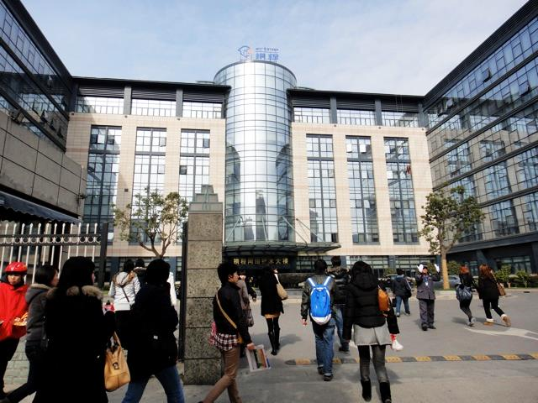
In 2012 I ran a randomized control trial of WFH on Ctrip, China’s largest travel agency ($15bn on NASDAQ, 40,000 employees)
6
Notes:
Average age is 23, 68% are women, and all have high school but only 39% have tertiary education. Only 15% are married, 9% have children.

Slide 7
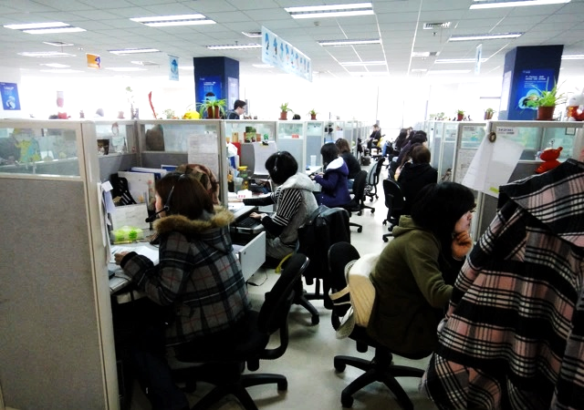
CTrip – inside is like a typical US office
7
Notes:
Average age is 23, 68% are women, and all have high school but only 39% have tertiary education. Only 15% are married, 9% have children.

Slide 8

The experiment was public: Chairman James Liang pulls the ball
Notes:
James is a SIEPR advisory board member

Slide 9
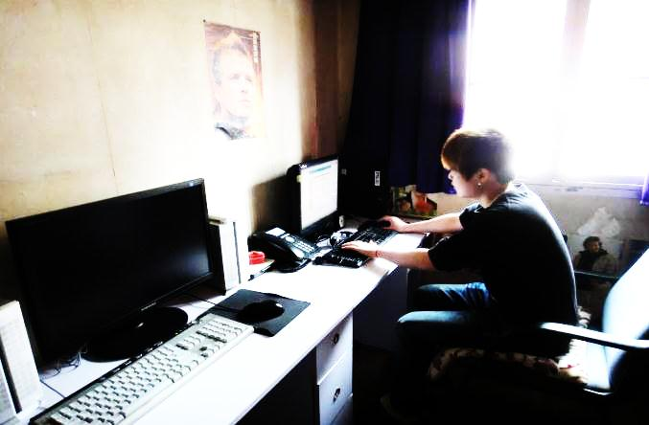
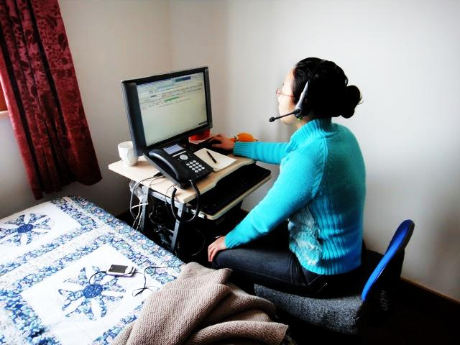
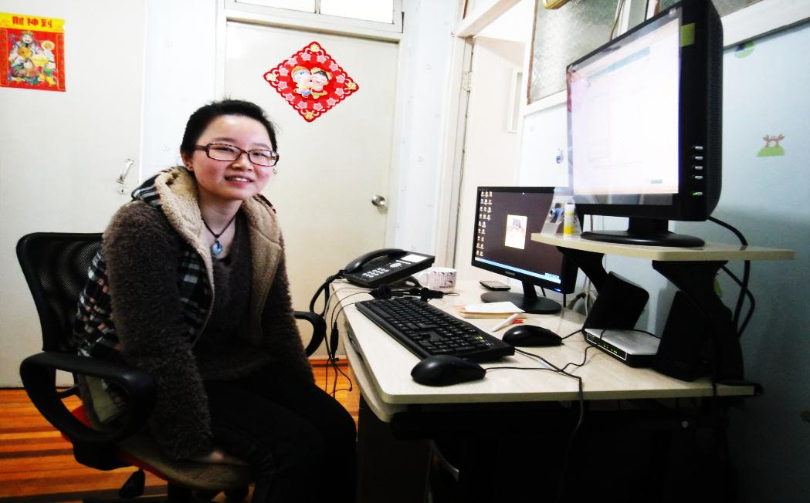
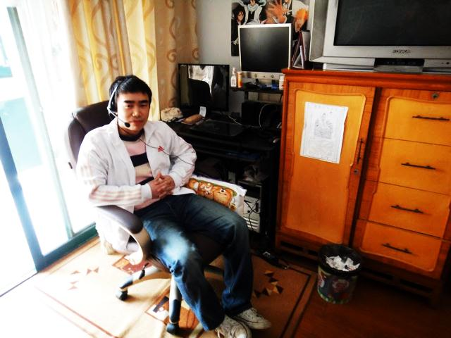
Individuals randomized home (even birthdays)
Working at home
Working at home
Working at home
Working at home

Slide 10
First, massive improvement in performance – 13% more output
% Improvement in performance
Weeks after the start of the experiment
Notes:
Ctrip assumed in advance productivity would drop – people WFH would watch the Chinese version of Oprah Winfrey or Netflix, play games or run their own side-business. Not work. So they assumed a big drop and were trying to find out how bad the hit to productivity was to evaluate against rent savings. Hence, they were totally amazed by this result – truly stunned!

Slide 11
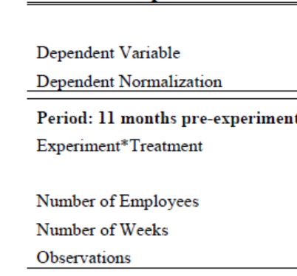
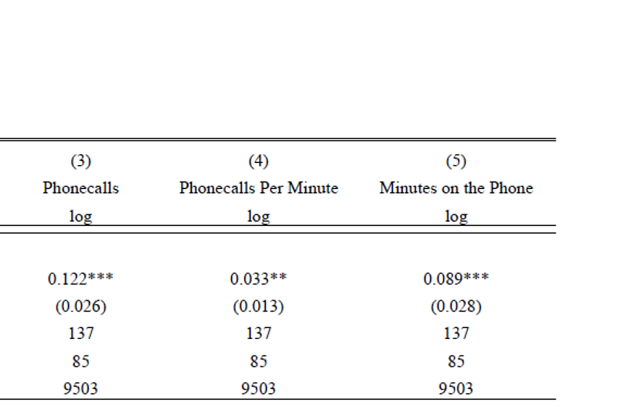
This 13% increase came 3.5% from more calls taken per minute and 9.5% from more minutes on the phone
Note: All regressions include a full set of individual and week fixed effects, with standard errors clustered by individual. Treatment=even birthday. Hours worked from log-in data. Outputs in logs (hence 12.2 log point increase is 13% (=exp(0.122)).

Slide 12
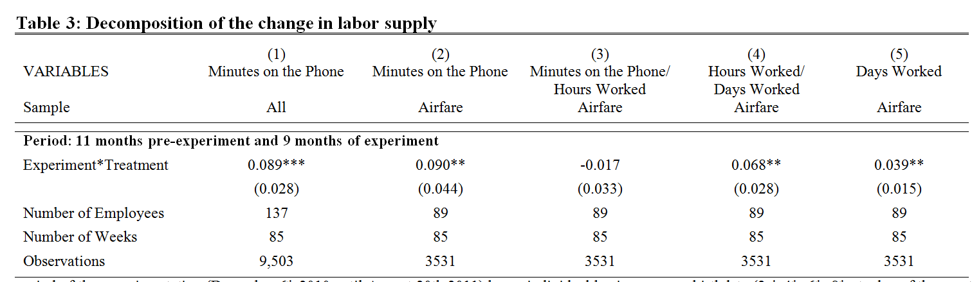
Minutes rose 9.5%, 2/3 due from more hours per day (↑punctuality and ↓tea-breaks) and 1/3 from more days worked (less “sick” days)
Note: All regressions include a full set of individual and week fixed effects, with standard errors clustered by individual. Treatment=even birthday. Hours worked from log-in data.

Slide 13
Second, quit rates drop by 50%
45
40
35
30
25
Office (●)
Cumulative quit rate (percent)
20
15
10
Home (♦)
5
0
0
2
4
6
8
10
12
14
16
18
20
22
24
26
28
30
32
34
36
38
Weeks after the start of the experiment
Notes:
Annual quit rate in Ctrip was 50% (staff lasted on average 2 years) which is about the same as the US average. Hence, this 50% reduction in quit rates took it from 50% down to 25%.

Slide 14
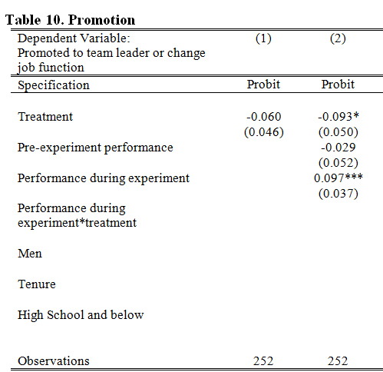
Third, promotions halved (once you control for performance)
Why?
Forgotten (out of sight)?
Develop less managerial skills
Do not want to be promoted
Note: Probit of promotion between Dec 6th, 2010 and Sep 30th, 2012, with robust standard errors

Slide 15
Fourth, choice matters: employees change their minds regularly
Experiment began on December 6th
Experiment ends on August 14th
Treatment (♦)
Share of employees working from home
Control (+)
Employees volunteer for WFH, August 12th
Non-volunteer (●)

Slide 16
Due to choice the impact of WFH after the experiment ended increased to 20% (low performers returned to the office)
Before the
experiment
During the experiment
Company
roll-out
% Improvement in performance
Weeks after the start of the experiment
Notes:
After the 9-month experiment ended employees go to reselect to WFH or in the office. As a result lower performing WFH employees returned to the office – those that tried it and it did not work out – so that the performance of the WFH remaining group rose further to +20%.

Slide 17

CTrip increased profits by $2,000 per employee working from home, and actively rolled this out

Slide 18
Working From Home Before COVID
Working From Home During COVID
Working From Home Post COVID
Tips on Working From Home

Slide 19
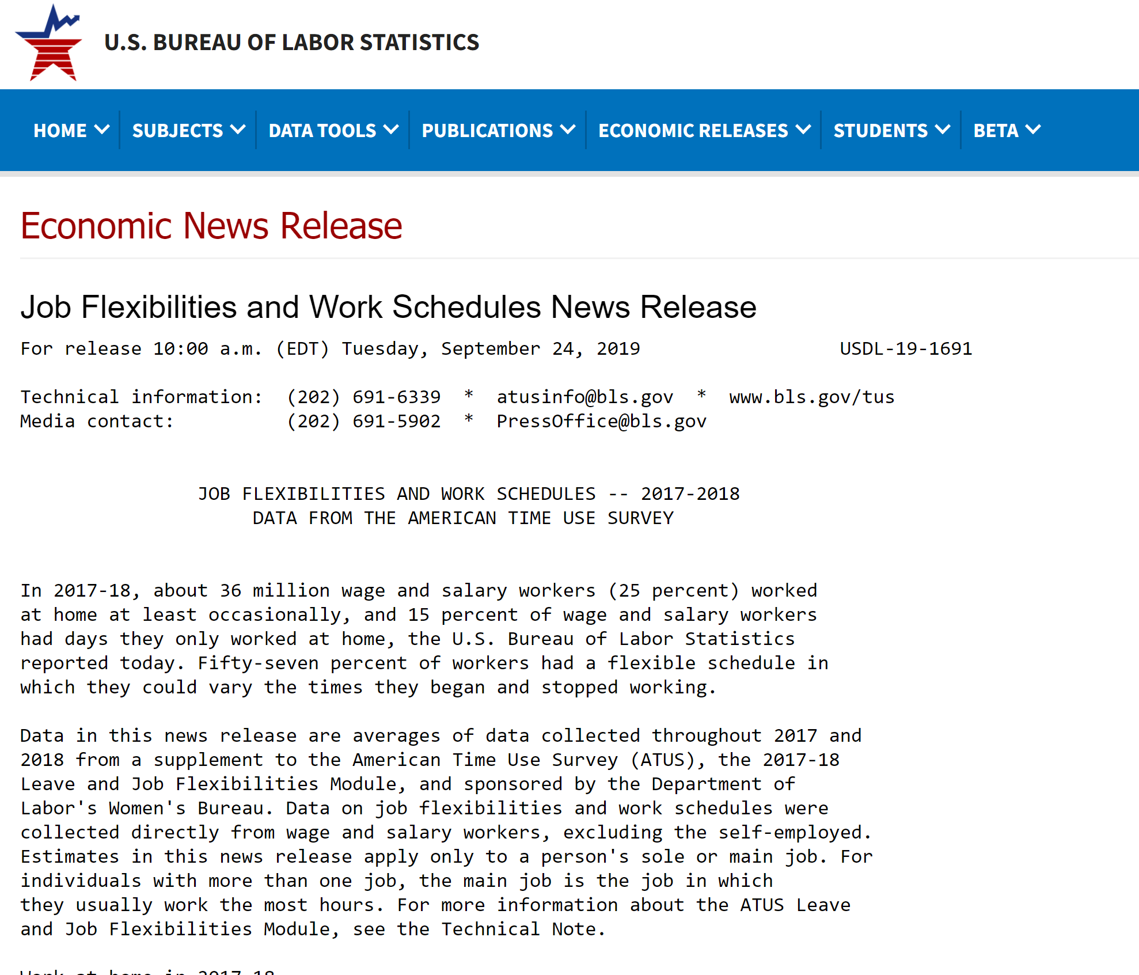
Main source of data a fantastic BLS survey
Surveyed continuously over 2017 and 2018 all wage and salaried workers (excluded self employed)
Collected around 10,000 responses stratified across states, industries and geographies
https://www.bls.gov/news.release/flex2.htm

Slide 20
Only 15% of Americans have paid full WFH days
Source: BLS data https://www.bls.gov/news.release/flex2.htm

Slide 21
Working from home is pretty balanced by gender and age
Source: BLS data https://www.bls.gov/news.release/flex2.htm

Slide 22
But WFH much higher for more educated higher-earners
Source: BLS data https://www.bls.gov/news.release/flex2.htm

Slide 23
Working from home far higher for managers and professionals
Source: BLS data https://www.bls.gov/news.release/flex2.htm

Slide 24
Working from home higher in professional service industries
Source: BLS data https://www.bls.gov/news.release/flex2.htm

Slide 25
Working From Home Before COVID
Working From Home During COVID
Working From Home Post COVID
Tips on Working From Home

Slide 26
During COVID 42% of US employees now full-time WFH,
( I estimate about 60% in Silicon Valley due to skill & industry mix)
Source: Response to the question “Currently (this week) what is your work status?” Response options were “Working on my business premises “, “Working from home”, “Still employed and paid, but not working “, “Unemployed, but expect to be recalled to my previous job “, “Unemployed, and do not expect to be recalled to my previous job “, and “Not working, and not looking for work “
Data from a survey of 2,500 US residents aged 20 to 64, earning more than $20,000 per year in 2019 carried out between May 21-29, by QuestionPro on behalf of Stanford University. Sample reweighted to match current CPS.
Shares shown weighted by earnings and unweighted (share of workers)

Slide 27




COVID WFH employees heavily drawn from city offices
Source: Data from a survey of 2,500 US residents aged 20 to 64, earning more than $20,000 per year in 2019 carried out between May 21-25 2020, by QuestionPro on behalf of Stanford University. Sample reweighted to match CPS and then current working from home rations in the 2017/2018 American Time Use Survey.

Slide 28
But working from home under COVID is hard for four reasons

Slide 29
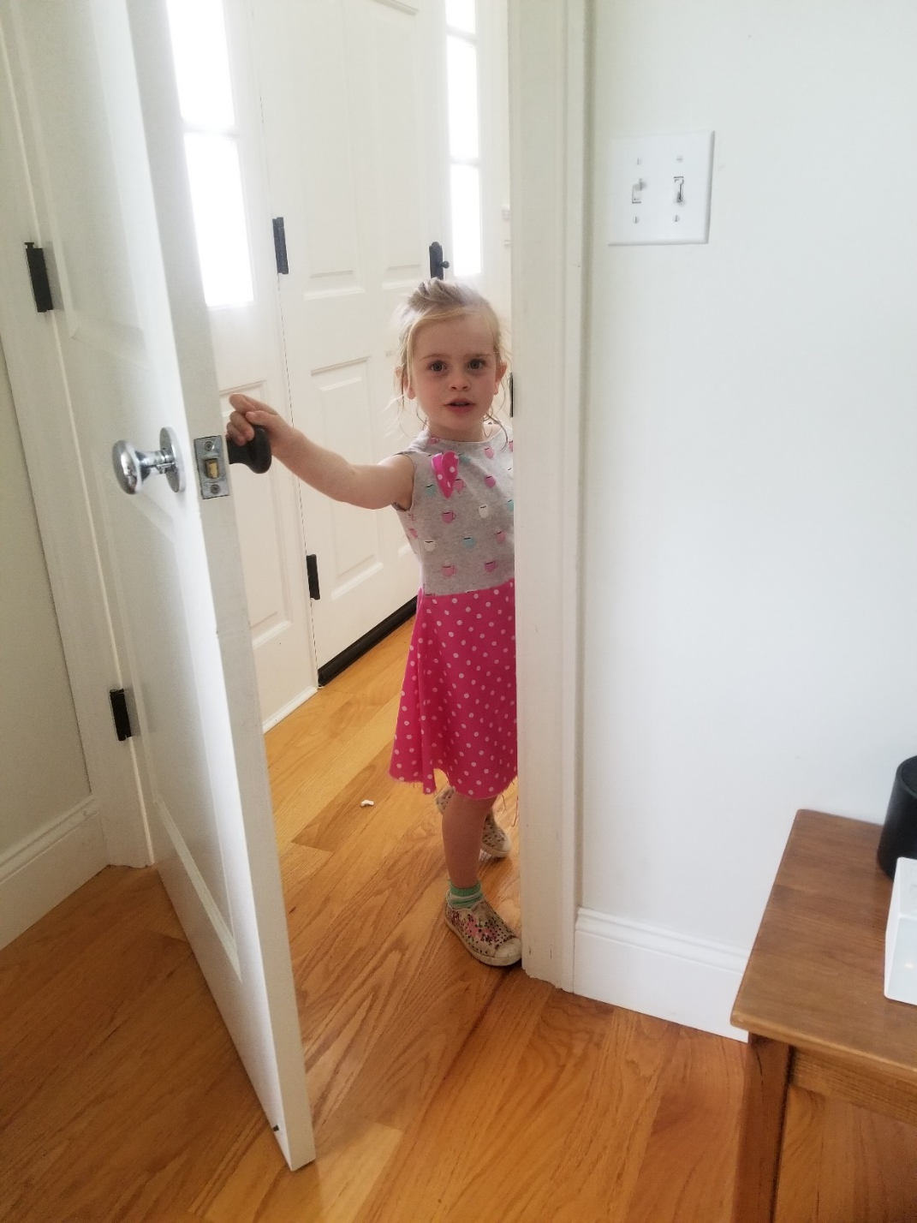
1) Kids
Notes:
https://www.youtube.com/watch?v=4jqQ_jE2FdE

Slide 30
2) Job match – only a third of jobs can fully work from home
Source: Response to the question “Could you do your job working from home?” Response options were “Completely, I would be 100%+ as efficient at home as at work “, “Mostly, I would be 80% to 90% as efficient at home as at work “, “Partly, I would be 50% to 70% as efficient at home as at work “, “Barely, I would be less than 50% as efficient at home as at work “, “No, I could not perform my job at home “
Data from a survey of 2,500 US residents aged 20 to 64, earning more than $20,000 per year in 2019 carried out between May 21-25 2020, by QuestionPro on behalf of Stanford University. Sample reweighted to match current working from home rations in the 2017/2018 American Time Use Survey.
See also “How many jobs can be done at home” Dingel and Nieman (2020), Covid Journal of Economics https://cepr.org/sites/default/files/news/CovidEcon1%20final.pdf,

Slide 31
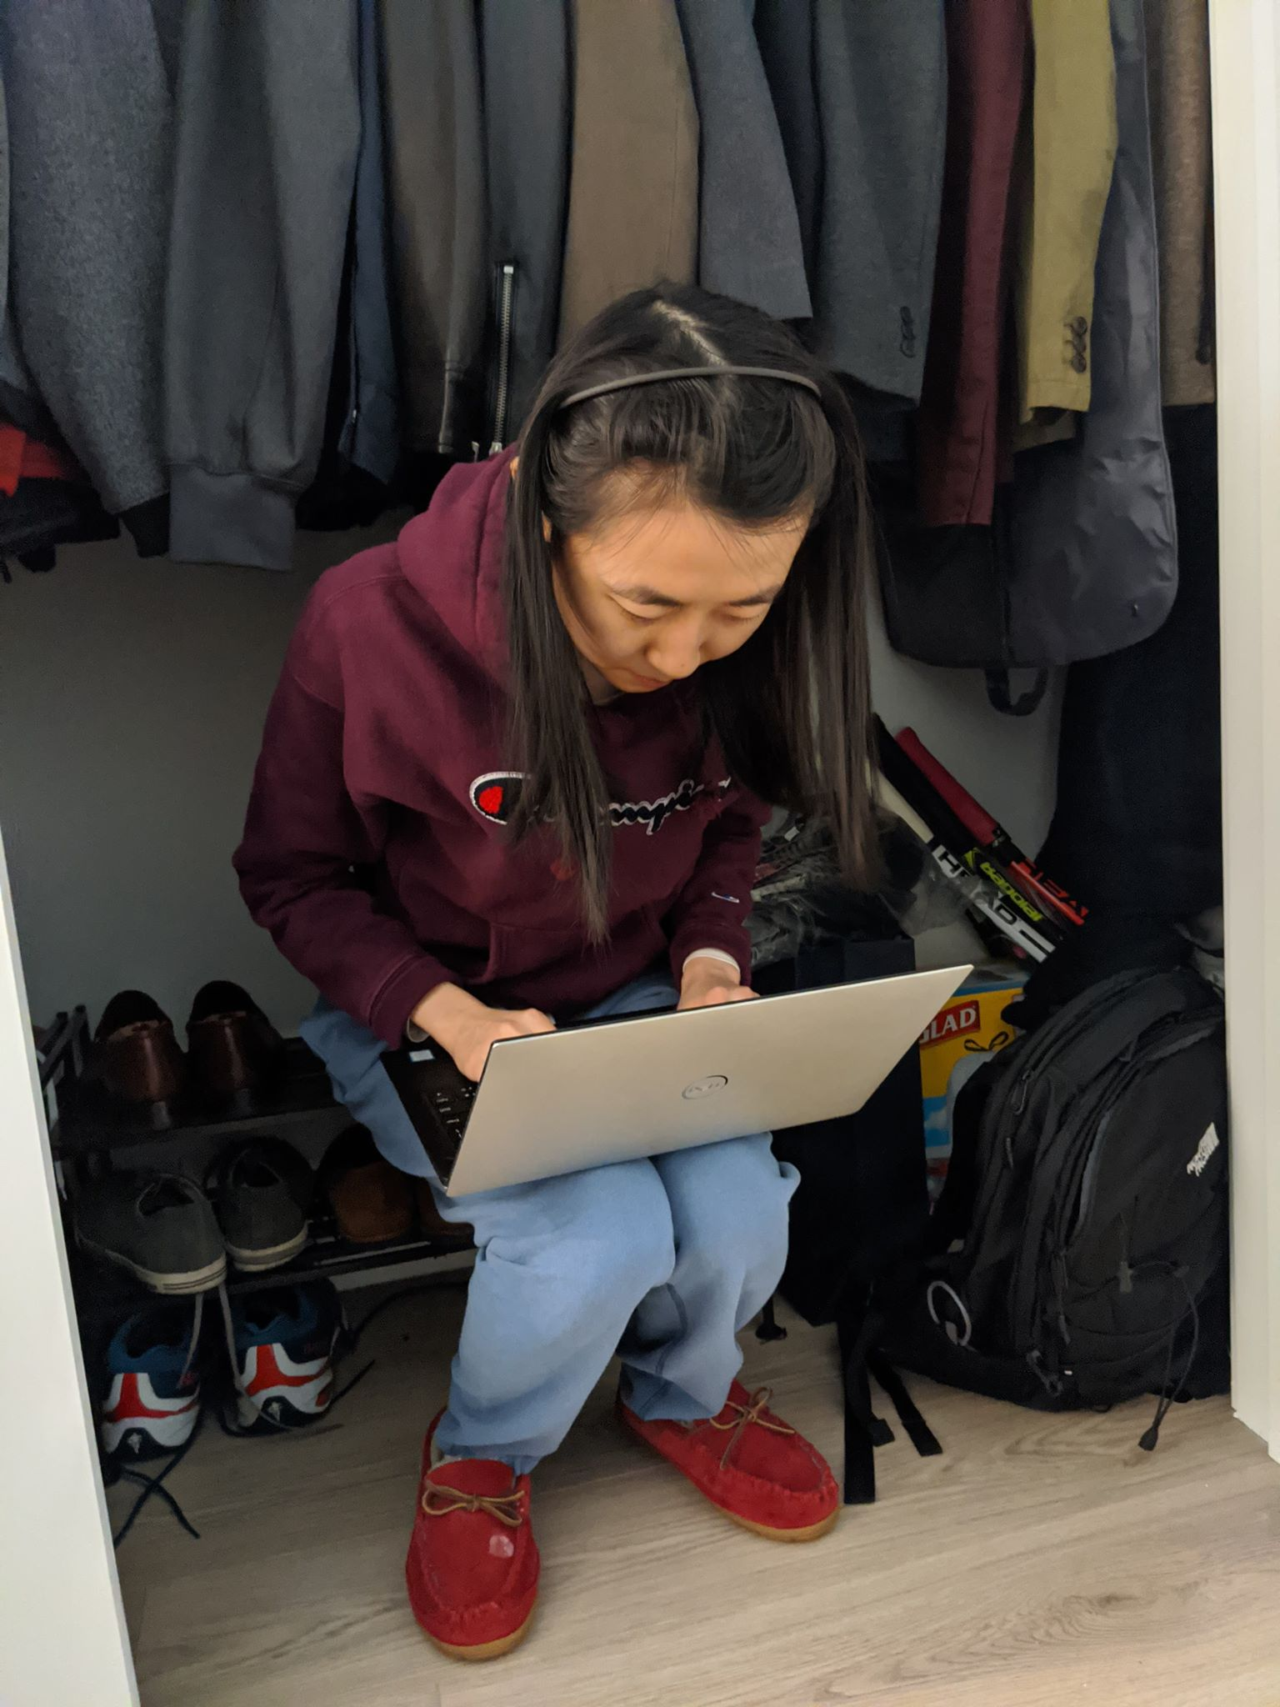
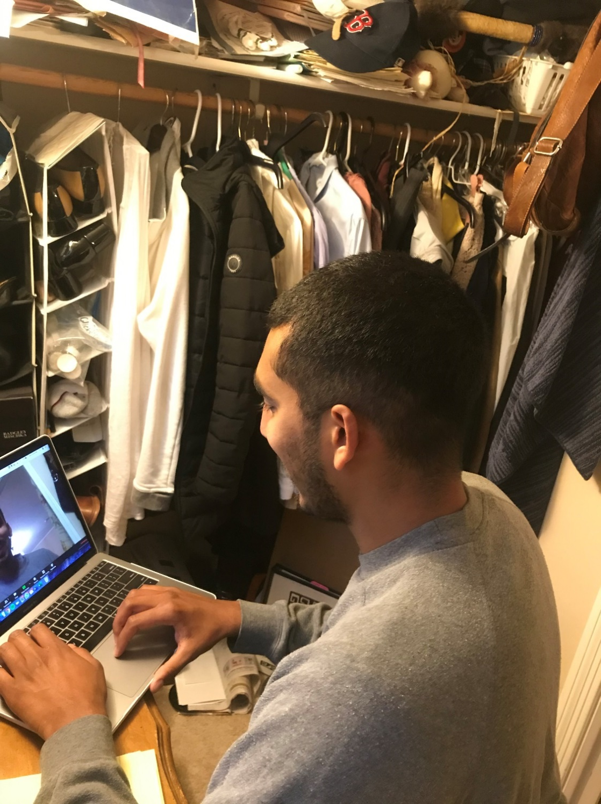
3) Space
If you have any photos to share of WFH challenges please send them to me at nbloom@stanford.edu thanks

Slide 32
Only 49% of Americans have their own room which is not their bedroom
Source: Response to the questions: “If you are working from home under COVID do you have your own room to work in?“
Data from a survey of 2,500 US residents aged 20 to 64, earning more than $20,000 per year in 2019 carried out between May 21-25 2020, by QuestionPro on behalf of Stanford University. Sample reweighted to match current working from home rations in the 2017/2018 American Time Use Survey.
Notes:
Ctrip (and other WFH companies pre-COVID) forbade anyone from WFH that: (1) Was looking after kids at home, (2) Did not have their own room which was not their bedroom, (3) Did not have good broadband connection.

Slide 33
And many have internet issues - so that 35% of Americans cannot effectively WFH (they have <90% connectivity so cannot video call)
Source: Response to the questions: “Internet: how effectively could you work from home online given your current internet connection?“
Data from a survey of 2,500 US residents aged 20 to 64, earning more than $20,000 per year in 2019 carried out between May 21-25 2020, by QuestionPro on behalf of Stanford University. Sample reweighted to match current working from home rations in the 2017/2018 American Time Use Survey.

Slide 34
4) Full-time – pre-COVID only 2% of WFH people were full time
Why? Office time important for
Creativity
Motivation
Loyalty
Source: BLS data https://www.bls.gov/news.release/flex2.htm

Slide 35
Working From Home Before COVID
Working From Home During COVID
Working From Home Post COVID
Tips on Working From Home

Slide 36
Post-COVID US firms forecast WFH at about 20% of days (compared to 5% pre-COVID and 40% during COVID)
Source: Consumers: Current Working From Home Status response to the question “In 2019 (before COVID) how often did you have a paid day working from home?”. Desired Working from Home Status response to the question “In 2021+ (after COVID) how often would you like to have paid work days at home?” Data from a survey of 2,500 US residents aged 20 to 64, earning more than $20,000 per year in 2019 carried out between May 21-25, by QuestionPro on behalf of Stanford University. Sample reweighted to match current working from home rations in the 2017/2018 American Time Use Survey.
Firms: Survey of Business Uncertainty from the Atlanta Federal Reserve Bank, Chicago University and Stanford University. Panel of around 1000 firms. See https://www.frbatlanta.org/blogs/macroblog
Headline figures of 5% and 40% of days WFH comes from adding up shares per option times the share of days working from home in each option (e.g. 6%=2.1% of 100% plus 4.5% of 70 plus 3.4% of 30% plus 4.7% of 1/22)

Slide 37
Employees – on average – also want about 50% WFH
Source: Response to the questios: “In 2021+ (after COVID) how often would you like to have paid work days at home?“
Data from a survey of 2,500 US residents aged 20 to 64, earning more than $20,000 per year in 2019 carried out between May 21-25, by QuestionPro on behalf of Stanford University. Sample reweighted to match current working from home rations in the 2017/2018 American Time Use Survey.

Slide 38
Three key tips of WFH post COVID
1) Part-time – regular 2 days per week at home (e.g. T,Th)
2) Optional – only about 50% of employees want to WFH
3) Privilege – under-performers warned, recalled to the office

Slide 39


COVID will relocate the modern office, not eliminate it
Pre-COVID 5% of working days from home
During COVID 40% of working days at home
Post COVID I predict about 20% of working days at home

Slide 40
Indeed, demand to work in high-rise buildings has dropped 25%
Source: Response to the questions: “In 2019 (before COVID) where did you mostly work (when not at home)?“ and “In 2021+ (after COVID) where would you like to mostly work (when not at home)?”
Data from a survey of 2,500 US residents aged 20 to 64, earning more than $20,000 per year in 2019 carried out between May 21-25, by QuestionPro on behalf of Stanford University. Sample reweighted to match current working from home rations in the 2017/2018 American Time Use Survey.

Slide 41
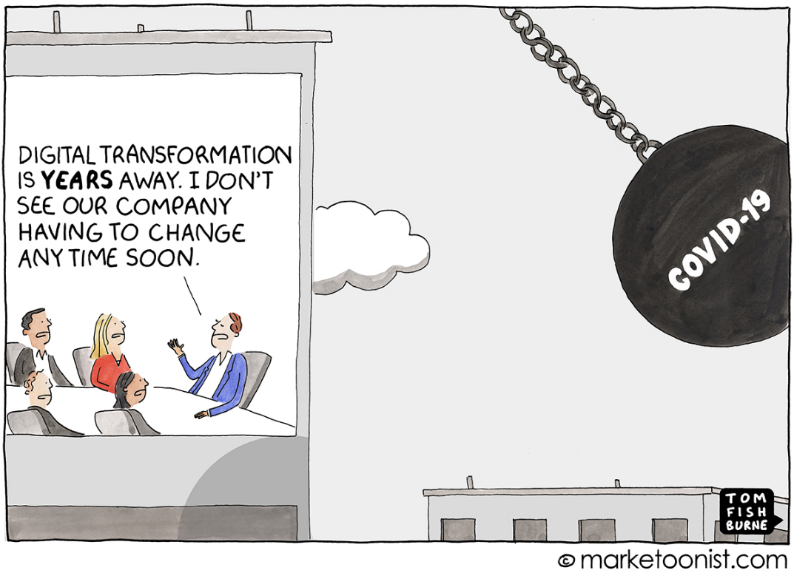
Further Reading References
Blog: “How Working from Home Works Out”, Nick Bloom, June 2020
https://siepr.stanford.edu/research/publications/how-working-home-works-out
Blog: Working remotely or remotely working? Best practices in working from home post COVID-19, May 2020
https://www.povertyactionlab.org/blog/5-18-20/working-remotely-or-remotely-working-best-practices-working-home-post-covid-19
Research paper: Does Working from Home Work?, QJE 2014
https://nbloom.people.stanford.edu/sites/g/files/sbiybj4746/f/wfh.pdf

