Slide 1
Leveraging the benefits of a multigenerational workforce
Mark Keese Head or the Skills and Employability Division Directorate for Employment, Labour and Social Affairs
Notes:
It is a great pleasure to welcome you to this joint OECD – AARP workshop to discuss the Challenges, Evidence and Knowledge Gaps in leveraging the benefits of a multigenerational workforce.
The aim of this workshop is to have a frank and open discussion among key stakeholders and experts to identify what are the main gaps in the evidence base and where further action is needed. We hope that this workshop will be a platform to learn from one another and find opportunities to collaborate on this very important topic.
To kick off the meeting, let me present an overview of recent work that we have been doing at the OECD, including joint work with AARP, to gather evidence that debunks several myths and demonstrates the positive impact of age diversity on firms, and which also identifies range of employer and public policies to strengthen retention, mobility and career advancement at all ages.

Slide 2
Population ageing slowing inflow of new talent
Share of firms reporting labour shortages:
rose from 34% in 2012 to 75% in 2022
By 2050, more than four in ten individuals across the OECD are likely to be over 50
On average, 30% of employees experience job strain
28% of jobs are at high risk of automation
Notes:
Why is this work important?
By 2050, more than four in ten individuals in the world’s most advanced economies are likely to be older than 50, limiting the inflow of new talent into the labour market.
Labour shortages – still very high – rose to historically high levels during the recovery from the COVID-19 crisis, underlining the importance of taking further action to improve worker retention and leverage better the talents of workers at all ages.
The twin digital and green revolutions, combined with longer working lives, will expose workers to a greater risk of skills obsolescence and job loss at older ages. The OECD estimates that on average occupations at risk of automation account for 28% of employment, but the risk varies hugely across countries and sectors.
Many workers may also be forced to change jobs because of poor job quality. The prevalence of hazardous and poor-quality jobs remains high. Across the OECD, 30% of workers experience job strain.

Slide 3
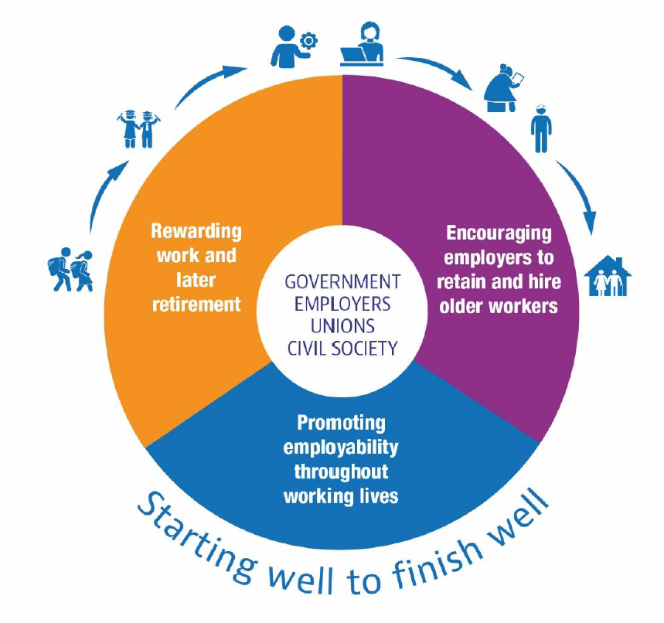
OECD policy agenda for better work choices at an older age
Notes:
In short, to cope with rapid population ageing in a fast-changing world of work, we need to promote longer lives and this means promoting better employment choices at an older age.
To do so requires a comprehensive approach, involving governments, employers, workers' representatives and civil society.
The 2015 OECD Council Recommendation on Ageing and Employment Policies sets out a three-pronged agenda to promote employment in later life:
First, strengthen incentives for longer working lives.
Second, encourage employers to retain and hire older workers
Third, promote employability throughout working lives.
So far, most policies have focused on reducing incentives for early retirement and rewarding longer working lives.
But sustained efforts are also needed to tackle demand-side barriers - we need workers who want to work longer, but also employers who want to employ them.
Indeed, much of the work that the OECD has been conducting in collaboration with the AARP specifically aims at giving employers promising approaches for successfully managing multigenerational workplaces.

Slide 4
Leveraging the benefits of a multigenerational workforce
Age diversity increases firm productivity: a +10% share in older workers → +1.1% productivity
Age discrimination remains common: 42% of workers 65+
6% of employers report concrete steps towards diversity and inclusion
Notes:
This first project that we did together with AARP looks into good practices and policies to promote an age-inclusive workforce.
The report estimates that building multigenerational workforces and giving older employees greater opportunities to work increases productivity in firms and could foster economic growth.
And while corporate executives are increasingly understanding the value of age diversity, age discrimination remains common, and the majority of firms still do not engage in concrete steps to train managers or promote diversity and inclusion strategies.

Slide 5
Employers play a crucial role in promoting job retention of older employees
Average job tenure declined by 8% between 2012 and 2019
Why leave?
1 in 4 workers leave their jobs because of low pay, they felt undervalued and lacked advancement
Notes:
Retaining talent at all ages is crucial for firms and people to prosper amid rapid population ageing and unprecedented labour and skills shortages.
In previous work we did jointly with AARP, we explored this very important aspect of talent retention at all ages.
The main finding from this report is that the average length of a job held by the same worker declined by around 8% (nine months) between 2012 and 2019, and the decline has been felt across all age groups.
To understand the reasons behind this trend, AARP conducted a survey among workers in 12 countries. The main reasons for quitting a job are low pay, feeling undervalued and lack of advancement in the job.
To support the retention of older workers, employers play a key role in promoting their upskilling and reskilling through job related training, and making sure that older workers are given opportunities for career advancement in their jobs.

Slide 6
Career mobility is crucial for older workers for better employment choices
The Midcareer Opportunity (launched 9th Oct)
Empirical report on mid-career mobility trends, drivers and consequences (launch early 2024)
Notes:
The other side of the coin of promoting longer working lives is to facilitate career shifts at older age agest. Not all workers want to continue working in the same job and some will be faced with job loss because of structural changes in the economy.
This is the main topic of our current work, together with Generation and the AARP.
The first part of this work is an employee and employer survey that we published yesterday,
The second part is an empirical report that will be launched early next year, in which we explore the trends, drivers and consequences of mobility at older ages.

Slide 7
Fostering a multigenerational workforce: Challenges, evidence and information gaps
Healthy workplaces
Skills development
Reducing barriers
Accountability,data and dissemination
Notes:
In this workshop, we will bring together this knowledge to identify future key topics that are linked to aging.
Poor health is still one of the most frequent reasons for job quits and for premature retirement, and poor working conditions are still too prevalent. Therefore, understanding how to build healthy workplaces that promote healthy work careers would seem to be an important issue for future work.
Skills development also continues to be a key topic where further action is needed. Despite the rhetoric of promoting lifelong learning. Older workers still engage in too little upskilling and reskilling. The discussion will focus on how lifelong learning can be made a reality and the importance of the recognition of skills acquired on the job. It will also focus on how to equip managers and business leaders with the right skills to manage a multigenerational workforce
Older workers also face additional barriers to work such as caregiving responsibilities and ageism. Therefore, another key area for future work is to understand better the role of firms in reducing workers’ barriers to work by taking into account the diverse needs of their workforce.
Lastly, promoting an age-diverse workforce and encouraging employment at older ages hinges on greater transparency in firm practices in managing an age-diverse workforce and disseminating good practice. Thus, a final topic for today’s discussion is how can firms safely disclose comprehensive and transparent data to fight age-related prejudices and embrace accountable Environmental, Social and Corporate Governance practices with respect to age-inclusive workforces..

